Slide 1



UNIT 4:
So much to do, so little time
Where does
the cat sleep?

Slide 2

What colour is the Tesla’s Club poster?
Where do the members of the Science club meet?
What’s the name of the School Choir?
What’s Marvel’s wonders club?
What day do members of the Marvel’s wonders club meet?
What time does the choir meet?

Slide 3
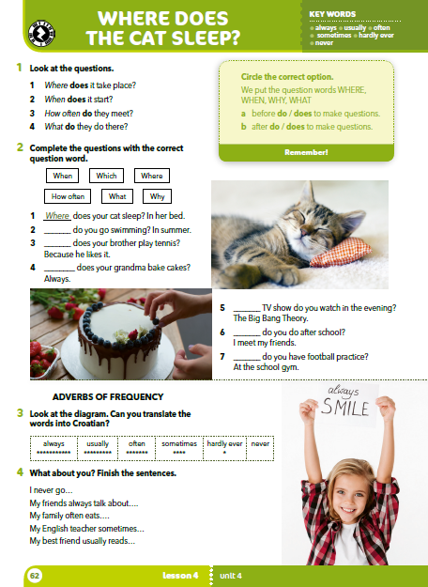
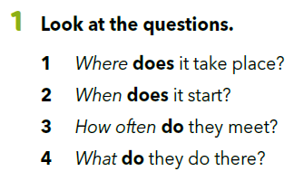
Gdje se održava?
Kad počinje?
Koliko često se oni sastaju?
Što oni rade tamo?

Slide 4
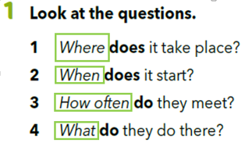
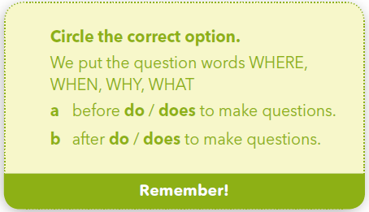
How do we form Wh-questions? Circle the correct option.

Slide 5
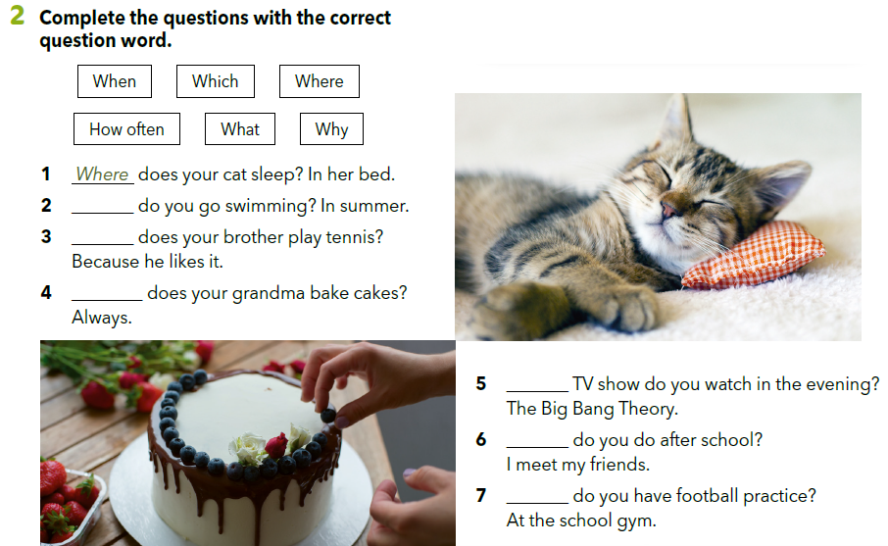
Nadopuni pitanja točnim upitnim riječima. Prije odabira riječi pažljivo pročitaj odgovore.
When
Why
How often
What
What
Where

Slide 6
Let’s practise!
Fill in the gaps with the correct question word.
https://wordwall.net/resource/256599/where-does-cat-sleep-pg-54-2

Slide 7
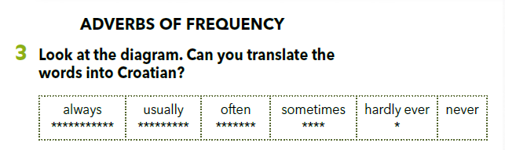
Prilozi učestalosti
uvijek
obično
često
ponekad
gotovo
nikada
nikada

Slide 8
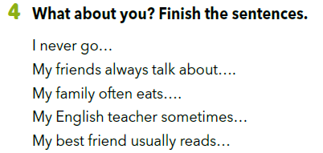
Write a sentence about yourself, which is true, but surprising – something nobody knows.
Use always, usually often, sometimes, hardly ever or never.

Slide 9
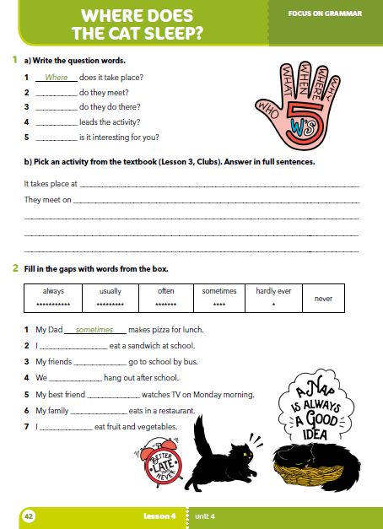
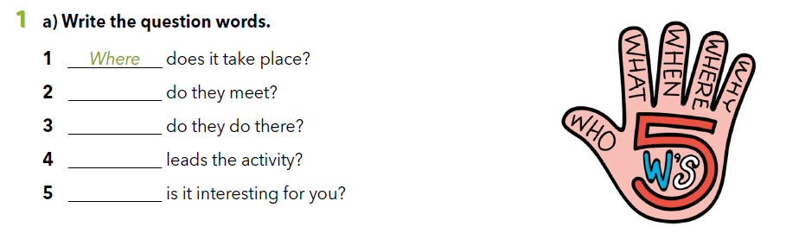
Workbook 42.
When
What
Who
Why

Slide 10
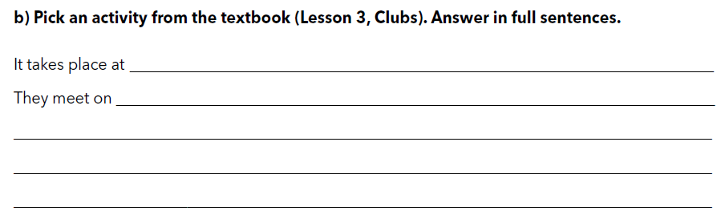

Slide 11
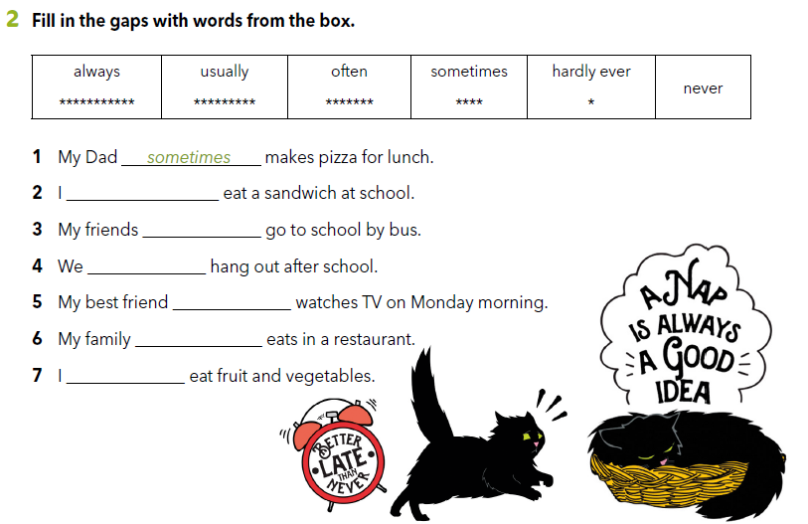

Slide 12
Let’s revise!
Click on the following link and fill in the gaps with the correct question word.
https://wordwall.net/resource/256600/where-does-cat-sleep

Slide 13

LEARN MORE.
https://www.e-sfera.hr/dodatni-digitalni-sadrzaji/7df867d4-d701-4d80-827d-2c59b52d40fa/
It’s a dog’s life!

Slide 14
SELF CHECK
https://www.e-sfera.hr/dodatni-digitalni-sadrzaji/7df867d4-d701-4d80-827d-2c59b52d40fa/

